Slide 1
Qualitätssicherung von Software
Prof. Dr. Holger Schlingloff
Humboldt-Universität zu Berlin
und
Fraunhofer FIRST

Slide 2
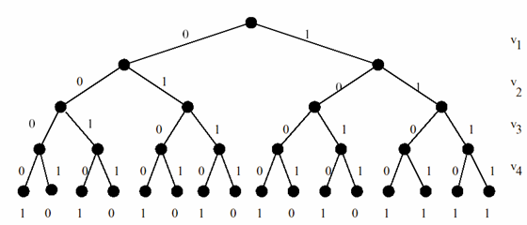
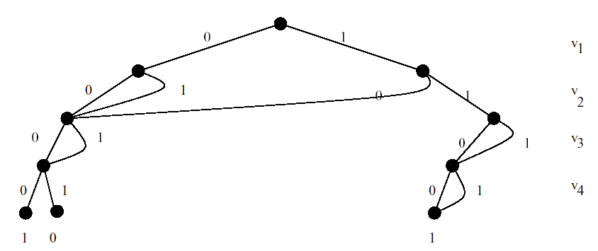
Binary Decision Trees (BDTs)
Binary decision tree
Elimination of
isomorphic subtrees
(abbreviations)

Slide 3
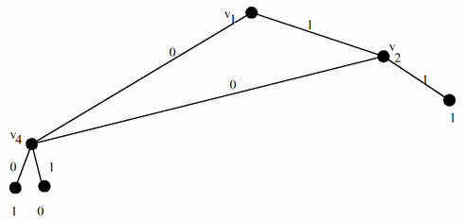
Binary Decision Diagrams (BDDs)
Elimination of
redundant nodes
(redundant subformulas)
Ite (v,ψ,ψ) by ψ

Slide 4
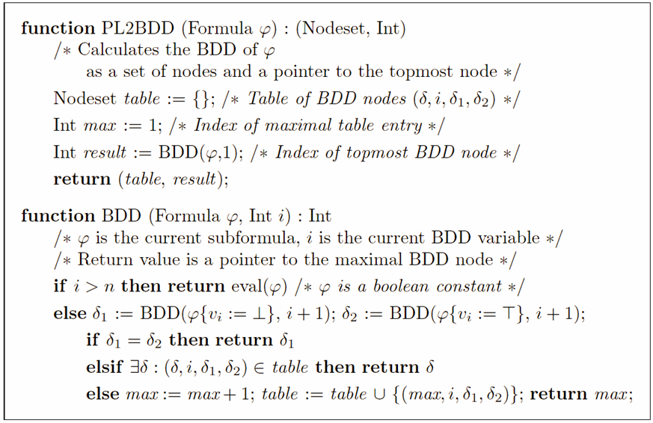
Calculation of BDDs

Slide 5
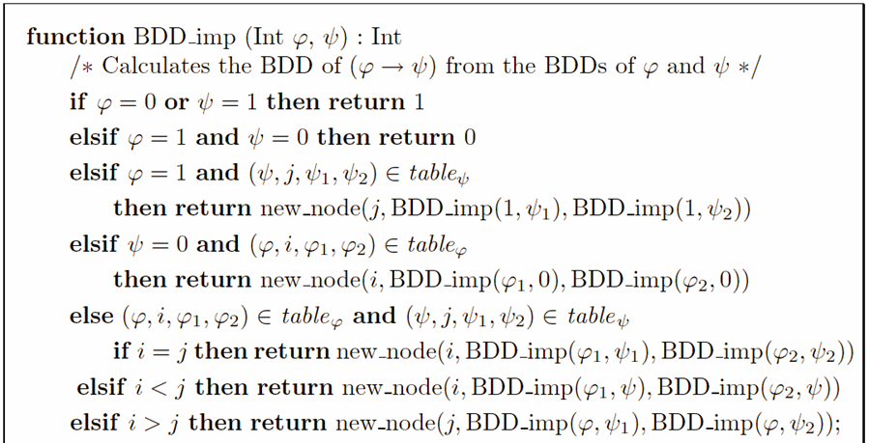
Boolean operations on BDDs

Slide 6
Generally
This procedure can be applied for arbitrary boolean connectives (or, and, not)
  this amounts to set union, intersection, and complement with respect to the base set
Substitution by constants is trivial
Boolean quantification:

Slide 7
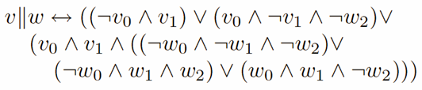
Binary Encoding of Relations
A relation is a subset of the product of two sets
  Thus, a relation is nothing but a set
Example: var v: {0..3}, w:{0..7};
  var v0, v1, w0, w1, w2: boolean;
  “divides”-Relation:
  v divides w iff
  v=1, or v=2 and w even,
  or v=3 and w in {0,3,6}
  boolean formula:
 | 0 | 1 | 2 | 3 | 4 | 5 | 6 | 7
0 | - | - | - | - | - | - | - | -
1 | + | + | + | + | + | + | + | +
2 | + | - | + | - | + | - | + | -
3 | + | - | - | + | - | - | + | -

Slide 8
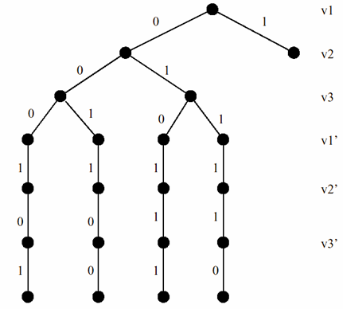
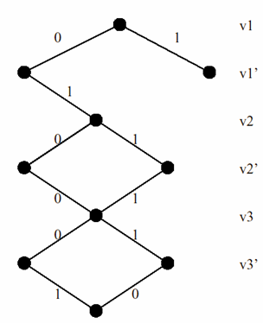
The Influence of Variable Ordering

Slide 9
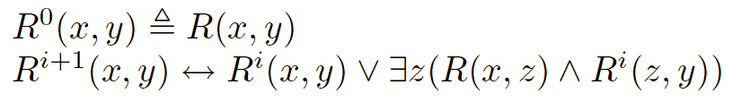
Transitive Closure
Each finite (transition) relation can be represented as a BDD
The transitive closure of a relation R is defined recursively by
Thus, transitive closure be calculated by an iteration on BDDs

Slide 10
Reachability
State s is reachable iff s₀R*s, where s₀∈S₀ is an initial state and R is the transition relation
Reachability is one of the most important properties in verification
  most safety properties can be reduced to it
  in a search algorithm, is the goal reachable?
Can be arbitrarily hard
  for infinite state systems undecidable
Can be efficiently calculated with BDDs

Slide 11

Pause!
(ein Screenshot)

Slide 12
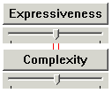
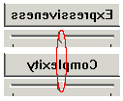
Logical Languages, Expressiveness
So far, we’ve been doing validation of systems without using anything but propositional logic!
It is more interesting (though not necessarily more practical) to consider more expressive logics
Dilemma:

Slide 13
Models
A model M is a graph consisting of
  a set of nodes U (universe)
  a transition relation R between nodes
    transitive closure of R denoted by <
  an initial node w₀
  an assignment I of propositions to nodes
q
p
p,q

Slide 14
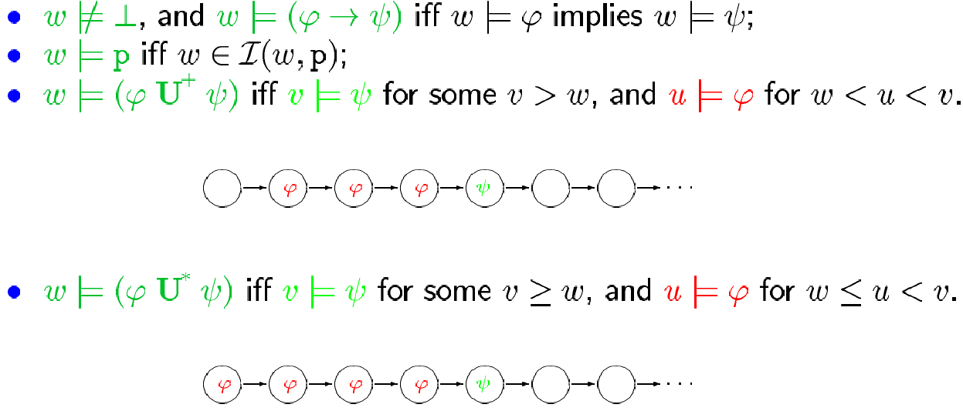
Temporal logic
“Modal logic with ‘until’”

Slide 15
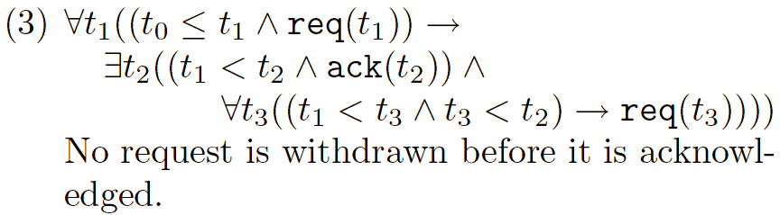

Examples

Slide 16
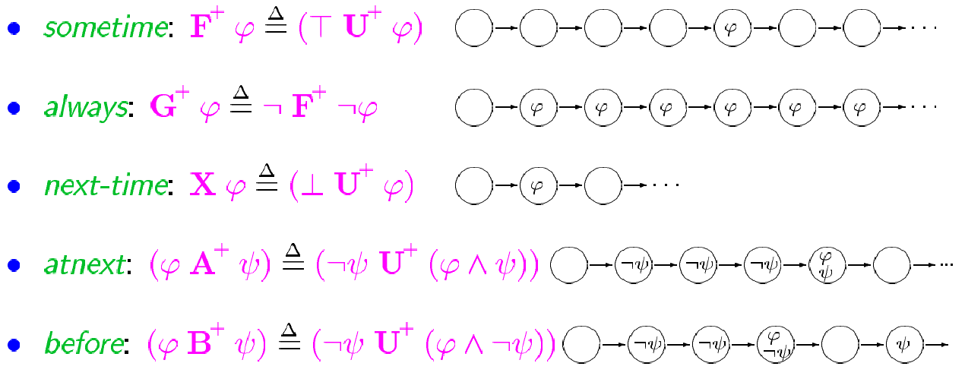
Other connectives

Slide 17
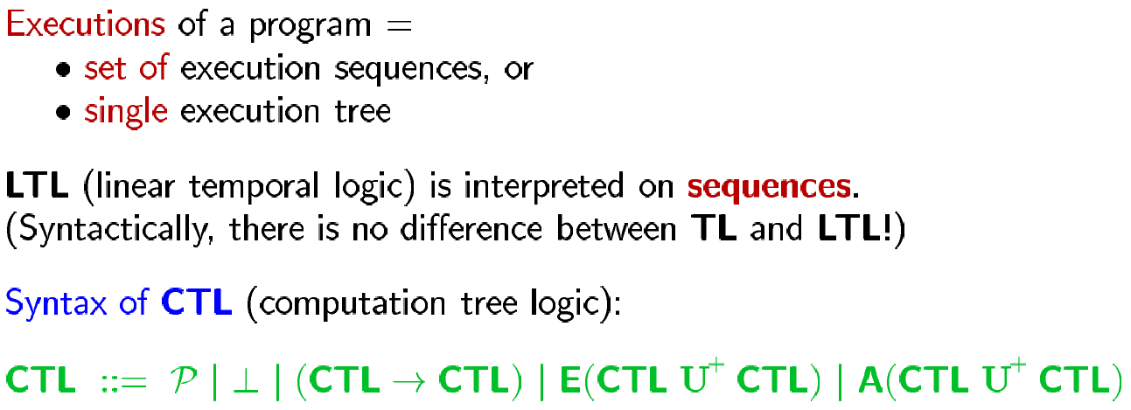
Linear and Branching Time Logics

Slide 18
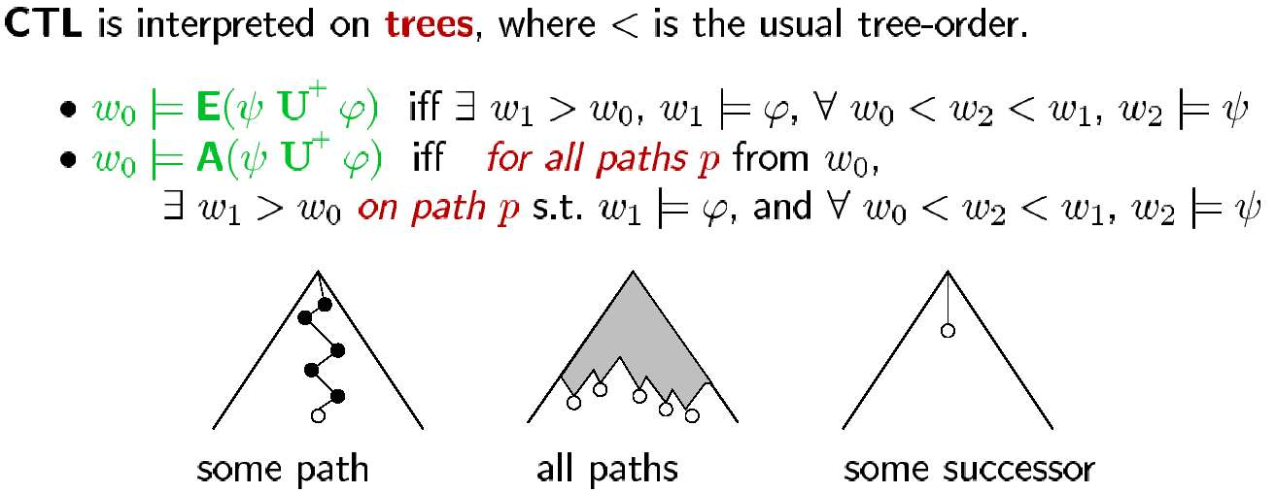
Semantics of CTL

Slide 19
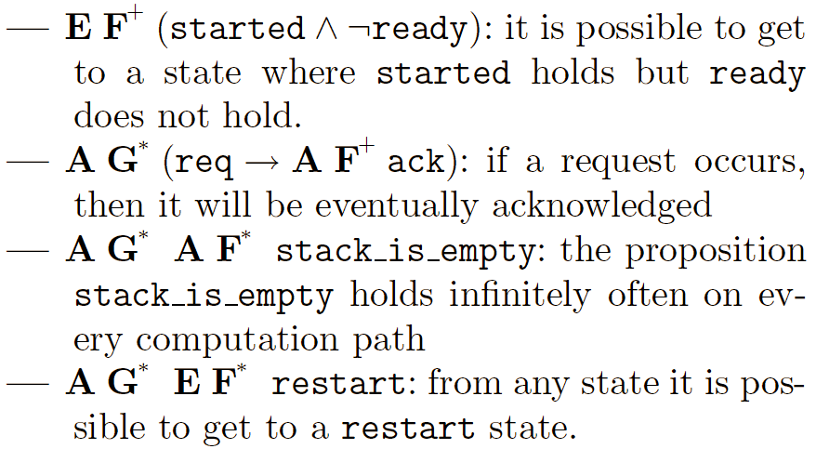
CTL Examples

Slide 20
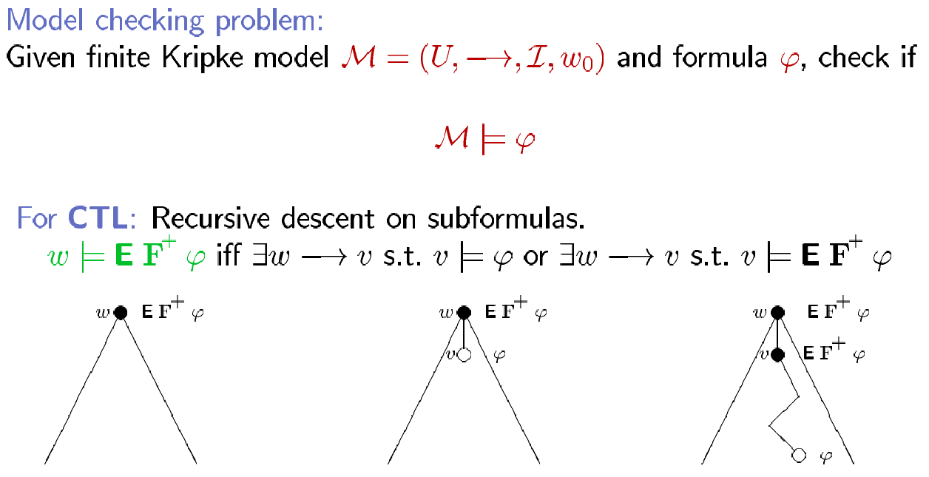
Model Checking

Slide 21
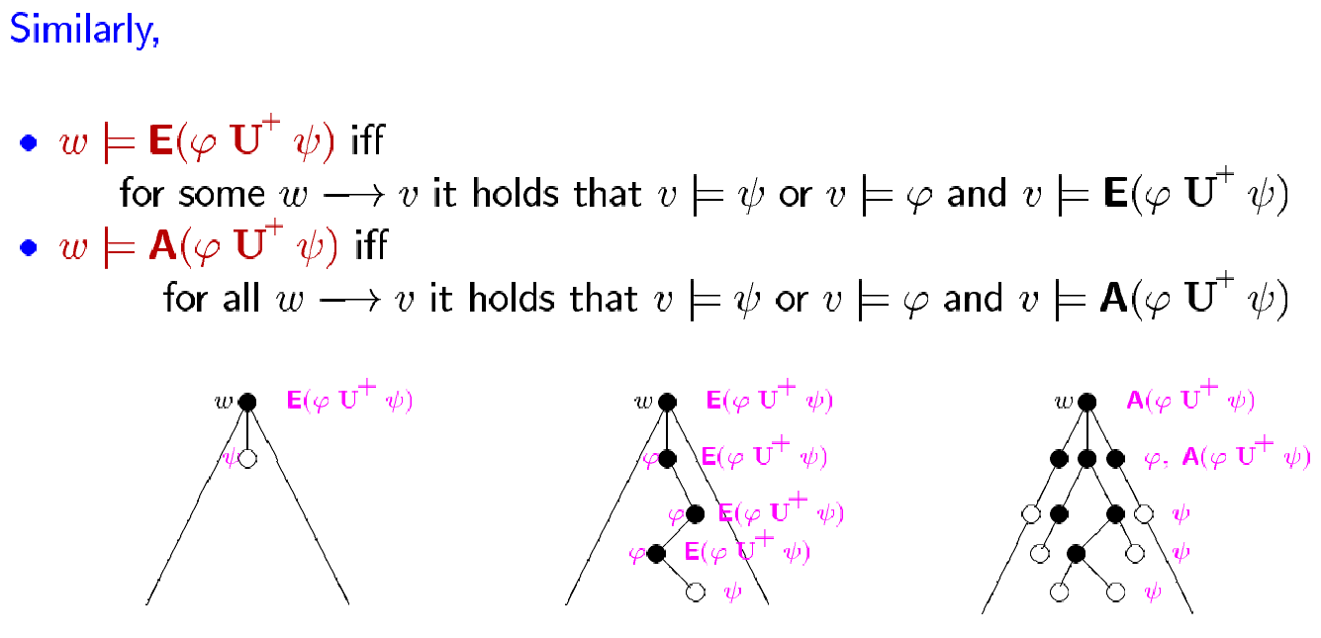

Slide 22
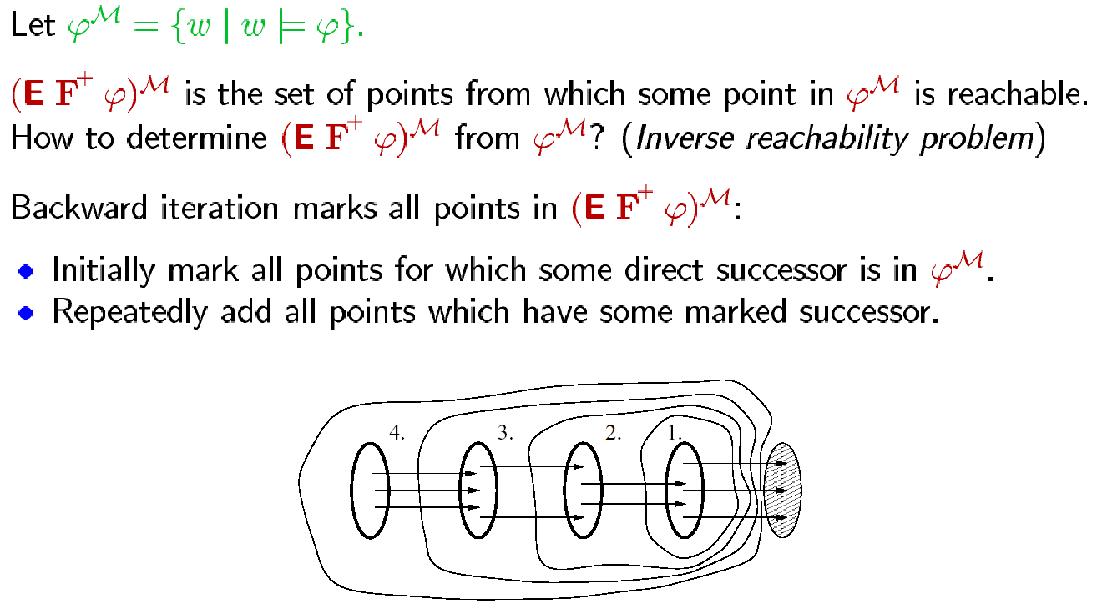

Slide 23
Comparison
CTL model checking
  uses sets, breath-first search
  can be directly implemented with BDDs
  systems: e.g. nuSMV
LTL model checking
  depth-first search, enumerates states
  implementation allows state-space hashing, partial order reduction etc.
  systems: e.g. SPIN

